Slide 1
IEEE 802.3 PoE

Slide 2
The PoE System and Current
PSEs have two current limits, Icut and Ilim
  Icut – PSE may shut power off
    Reached when PD draws more than advertised class for more than 75ms
  Ilim – PSE shall shut power off
    Reached when PD draws exceeds advertised class by a percentage for a duration
    Percentage and duration varies by class (both get smaller as class increases)
Notes:
The Icut and Ilim boundaries were defined to give a minimum and maximum current limits and allow PSEs to design tolerance between the two (instead of having finite limits, which would be expensive). This is why the lower limit is MAY and the upper is SHALL. This does not preclude a PSE from having a lower limit closer to Icut (say via ‘sloppy’ SW) and a higher limit close to Ilim (via HW).

Slide 3
Limited Fault Power
These current limits are chosen to ensure compliance to safety standards (60950 moving to 62368)
IEEE Std 802.3 attempts to simplify the comprehension of the limits by including an ‘upperbound template’

Slide 4
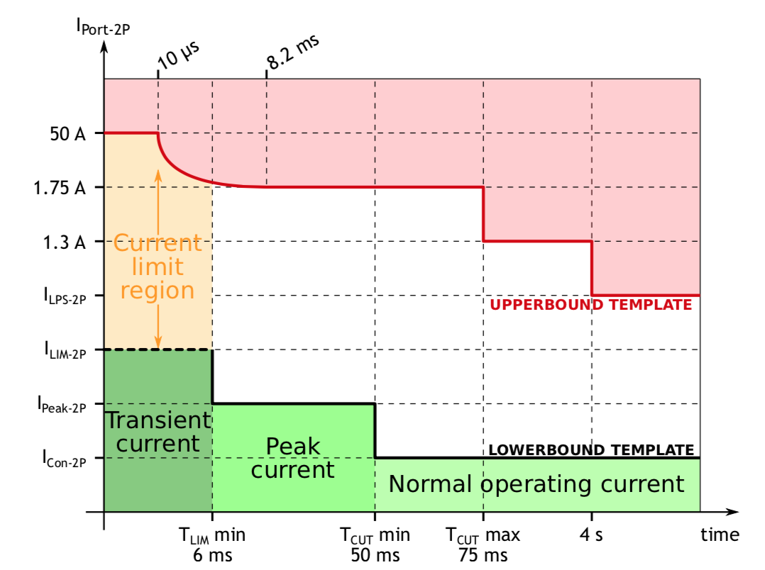
Upperbound Template
The upperbound template is a graphical representation of the current limits. Green is operational area, white is may shut off and red is shall shut off.
A Type 4 PSE may source up to 1.75A for up to TCUT max (75ms), with a 750ms error delay before the PSE can apply power.
Picture Source: https://ethernetalliance.org/wp-content/uploads/2018/04/WP_EA_Overview8023bt_FINAL.pdf

Slide 5
Auto Restart
The PSE moves back to detection after shutting off power to the port
If the PD presents valid detection and classification signatures and falls within the startup inrush current limits, power will be reapplied
The PSE has error delay timing that requires a 750ms delay before subsequent powering attempts, limiting the duty cycle of any error event to less than 10%
Customers do not want to manually intervene for overload

Slide 6
Intent of IEC 60364-7-716
Is the intent to disallow lower current limits that can self reset even when a higher overcurrent protection (non-resettable) is present?
  The current text can be read to disallow this
  It can also be interpreted to allow this
The protection against thermal effects and overcurrent shall be achieved by at least one of the three following principle measures:
  - use of a protective device to disconnect any overcurrent in the circuit conductors
  - designing the circuit so as to prevent an overcurrent to arise
  - limitation of overcurrent by the characteristics of supply
Overload protection shall be provided by limitation of the power supply for all parallel sources of the power supply devices. The disconnection in case of overload shall be within 1 s. The circuit shall not reset automatically.

