Slide 1
IEEE 802.3bp 1000BASE-T1 PHY D1.1
Proposed changes to Figure 98-3

Slide 2
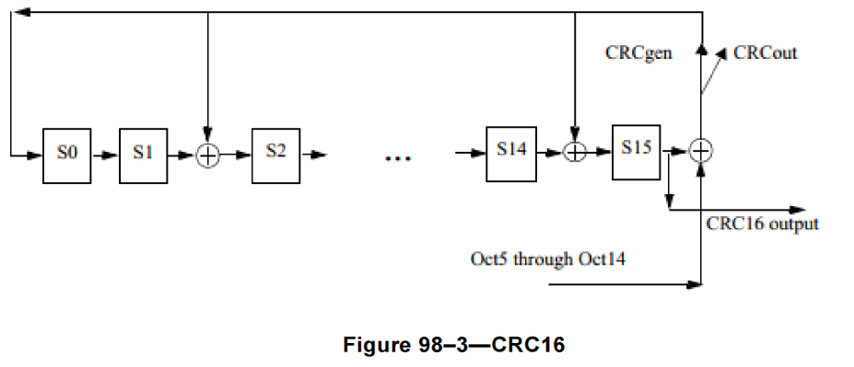
Proposed changes to Figure 98-3
This presentation is related to comment #88 on IEEE 802.3bp D1.1
Per the comment:
  Figure 98-3 has a couple of unclear items:
    The input states "Oct5 through Oct14". In all other parts of this subclause, we refer to the data in terms of transition positions, not octets. Also, it is not clear if the Octet count is zero or one based.
    The CRCGen vs. CRCout switch is not clear as to its value in the CRCout state.
Here is the current Figure as it appears in D1.1:

Slide 3
Proposed changes to Figure 98-3
Proposed Remedy:
  Replace "Oct5 through Oct14" with "Auto Negotiation Page Data". The description of the translation present or absent even bit positions to data bits is already present in text (and in Figure 98-5) so it does not need to appear in this figure (Figure 98-3).
  Show the CRCgen vs. CRCout switch as a multiplexer (or relay) that had a "0" input in the CRCout state and the input from the XOR below in the CRCgen state.

