Slide 1
Additional link segment motions
05/17/2023

Slide 2
Introduction
Alien parameters are specified in a way that auto-negotiation (goal 4) is not secured. Hereafter are proposals to fix this as described in Fischer_3dg_01_05172023.
As highlighted in the document, MC is a very important parameter for 100Base-T1L. Therefore we need a specification for unscreened links (TCL) and screened links (coupling attenuation) on a similar level.

Slide 3
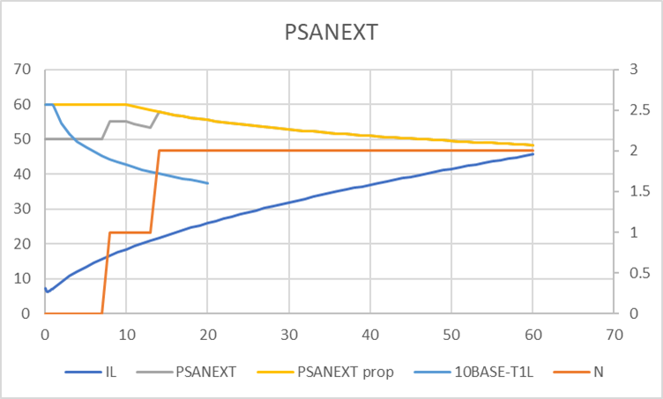
Motion #1
I support to improve the PSANEXT specification as proposed in graber_3dg_01_03152023 and Fischer_3dg_01_05172023.
Moved: Peter Fischer
2nd: Hans Lackner
Y:
N:
A:
PSANEXT 500m

Slide 4
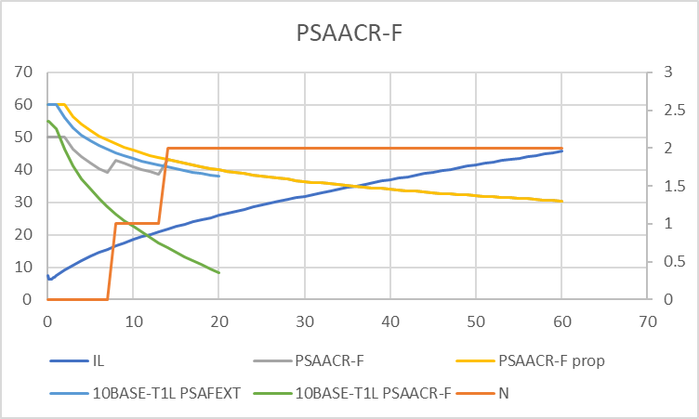
Motion #2
I support to improve the PSAACR-F specification as proposed in graber_3dg_01_03152023 and Fischer_3dg_01_05172023.
Moved: Peter Fischer
2nd: Hans Lackner
Y:
N:
A:
PSAACR-F 500m

Slide 5
Motion #3
I support to add a requirement for coupling attenuation for screened links and use the TCL requirement for unscreened links.
Moved: Peter Fischer
2nd: Hans Lackner
Y:
N:
A:

Slide 6
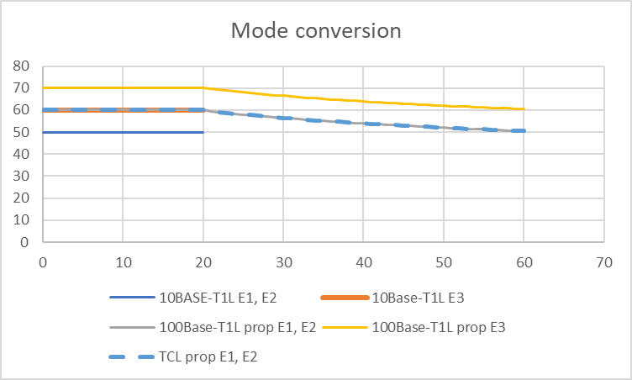
Motion #4
I support to add/ improve the requirement for TCL for unscreened links and E1/E2 to the level proposed in Fischer_3dg_01_05172023.
Moved: Peter Fischer
2nd: Hans Lackner
Y:
N:
A:

