Slide 1
Project: IEEE P802.15 Working Group for Wireless Personal Area Networks (WPANs)
Submission Title: [NIST Framework for Smart Grid Interoperability Standards, Release 1.0]
Date Submitted: [21 September 2009]
Source: [Nada Golmie] Company [NIST]
Address [100 Bureau Dr. Stop 8920, Gaithersburg, MD 20899]
Voice:[301 975 4190], E-Mail:[ golmie@nist.gov]
Re: []
Abstract: [This presentation gives an overview and highlights of the NIST Framework document]
Purpose: []
Notice: This document has been prepared to assist the IEEE P802.15. It is offered as a basis for discussion and is not binding on the contributing individual(s) or organization(s). The material in this document is subject to change in form and content after further study. The contributor(s) reserve(s) the right to add, amend or withdraw material contained herein.
Release: This contribution is from the National Institute of Standards and Technology and contents are no subject to copyright in the US.

Slide 2
The NIST Role
Energy Independence and Security Act (EISA) of 2007
Title XIII, Section 1305.
Smart Grid Interoperability Framework
In cooperation with the DoE, NEMA, IEEE, GWAC, and other stakeholders, NIST has “primary responsibility to coordinate development of a framework that includes protocols and model standards for information management to achieve interoperability of smart grid devices and systems…”

Slide 3
NIST Three Phase Plan
PHASE 1
Engage stakeholders in a participatory public process to identify applicable standards, gaps in currently available standards and priorities for new standardization activities
PHASE 2
Establish a formal standards panel to drive longer-term progress.
Public review
and comments
PHASE 3
Develop and implement a framework for testing and certification
(Draft) Framework and Roadmap for Smart Grid Interoperability Standards ( Release 1.0)
(Final) Framework and Roadmap for Smart Grid Interoperability Standards ( Release 1.0)
2009
2010
March
September
3

Slide 4
First Phase Output: NIST Framework and Roadmap for Smart Grid Interoperability Standards, Release 1.0
A conceptual reference model to facilitate design of an architecture for the Smart Grid overall and for each of its networked domains;
An initial set of standards;
Priorities for additional standards necessary to resolve important gaps and to assure the interoperability, reliability, and security of Smart Grid components; and
Action plans for responding to short-term and long-term needs for standards, including recommended timetables and assignments of responsibilities to standards development organizations (SDOs) with expertise in Smart Grid domains or technology areas

Slide 5
Input to Report
Executives meeting with Secretaries Locke and Chu
Recommendations from the general public during stakeholder-engagement workshops (April and May 2009) that have involved about 1,500 people
Technical contributions of six domain expert working groups (DEWGs) established by NIST in 2008.
EPRI report to NIST on the Smart Grid Interoperability Standards Roadmap in June 2009 http://www.nist.gov/smartgrid/
Standard panel workshop in August 2009

Slide 6
Priority Areas
Wide-area situational awareness: Monitoring and display of power-system components and performance across interconnections and wide geographic areas in near real-time
Demand response: Mechanisms and incentives for business and residential customers to cut energy use during times of peak demand.
Electric storage: Means of storing electric power, directly or indirectly
Electric transportation: Refers, primarily, to enabling large-scale of plug-in electric vehicles (PEVs)
Advanced metering infrastructure (AMI): Primary means for utilities to interact with meters at customer sites.
Distribution Grid Management: Maximizing performance of feeders, transformers, and other components of networked distribution systems and integrating with transmission systems and customer operations.

Slide 7
NIST-identified Standards for Implementation
Preliminary list developed
  http://collaborate.nist.gov/twiki-sggrid/bin/view/_SmartGridInterimRoadmap/SGR1Standards
  Using the following criteria:
  Standard was supported by a standards development organization (SDO) or via an emergent SDO process.
  Standard is also supported by a users’ community.
  Standard is directly relevant to the Use Cases analyzed for the Smart Grid .
  Consideration was given to those standards with a viable installed base and vendor community.
Solicitation of further public comments and recommendations on existing standards or emerging specifications for inclusion in the final version of Release 1.0.

Slide 8
Criteria for Standards Inclusion in Release 1.0
Is well-established and widely acknowledged as important to the Smart Grid.
Enables the transition of the legacy power grid to the Smart Grid.
Has, or is expected to have, significant implementations, adoption, and use.
Is supported by an SDO or Users Group to ensure that it is regularly revised and improved to meet changing requirements and that there is strategy for continued relevance.
Addresses, or is likely to address, anticipated Smart Grid requirements identified through the NIST workshops and other stakeholder engagement.
Is applicable to one of the priority areas identified by FERC and NIST:
  Demand Response and Consumer Energy Efficiency, Wide Area Situational Awareness, Electric Storage, Electric Transportation, Advanced Metering Infrastructure, or Distribution Grid Management.
Addresses cyber-security, network communications, or other cross-cutting issues.
Focuses on the semantic understanding layer of GWAC stack , which has been identified as most critical to Smart Grid interoperability.
Is openly available under fair, reasonable, and nondiscriminatory terms.
Accommodates legacy implementations.
Allows for additional functionality and innovation through:
  Loose coupling – helps to create a flexible platform that can support valid bilateral and multilateral transactions without elaborate pre-arrangement.*
  Layered systems – separates functions, with each layer providing services to the layer above and receiving services from the layer below.
  Shallow integration – does not require detailed mutual information to interact with other managed or configured components.
  Symmetry – facilitates bi-directional flows of energy and information.
  Transparency – supports a transparent and auditable chain of transactions.
  Composition – facilitates building of complex interfaces from simpler ones.
  Extensibility – enables adding new functions or modifying existing ones.
Has associated conformance tests or a strategy for achieving them

Slide 9
Smart Grid Vision: Key Attributes
Mature Requirements
Criteria and Metrics for Standards
Flexible Architectures
Different Levels of Interoperability
Support Infrastructure
Information Network

Slide 10
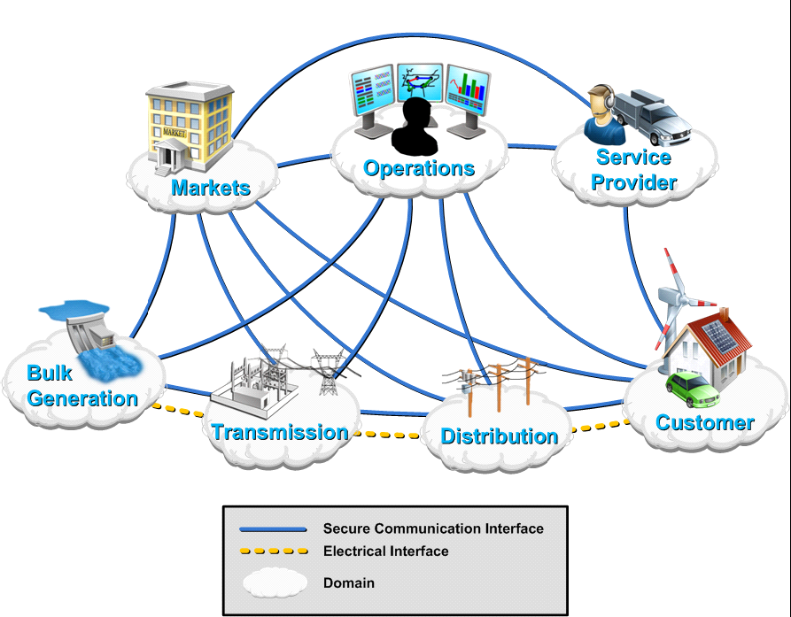
Conceptual Reference Model

Slide 11
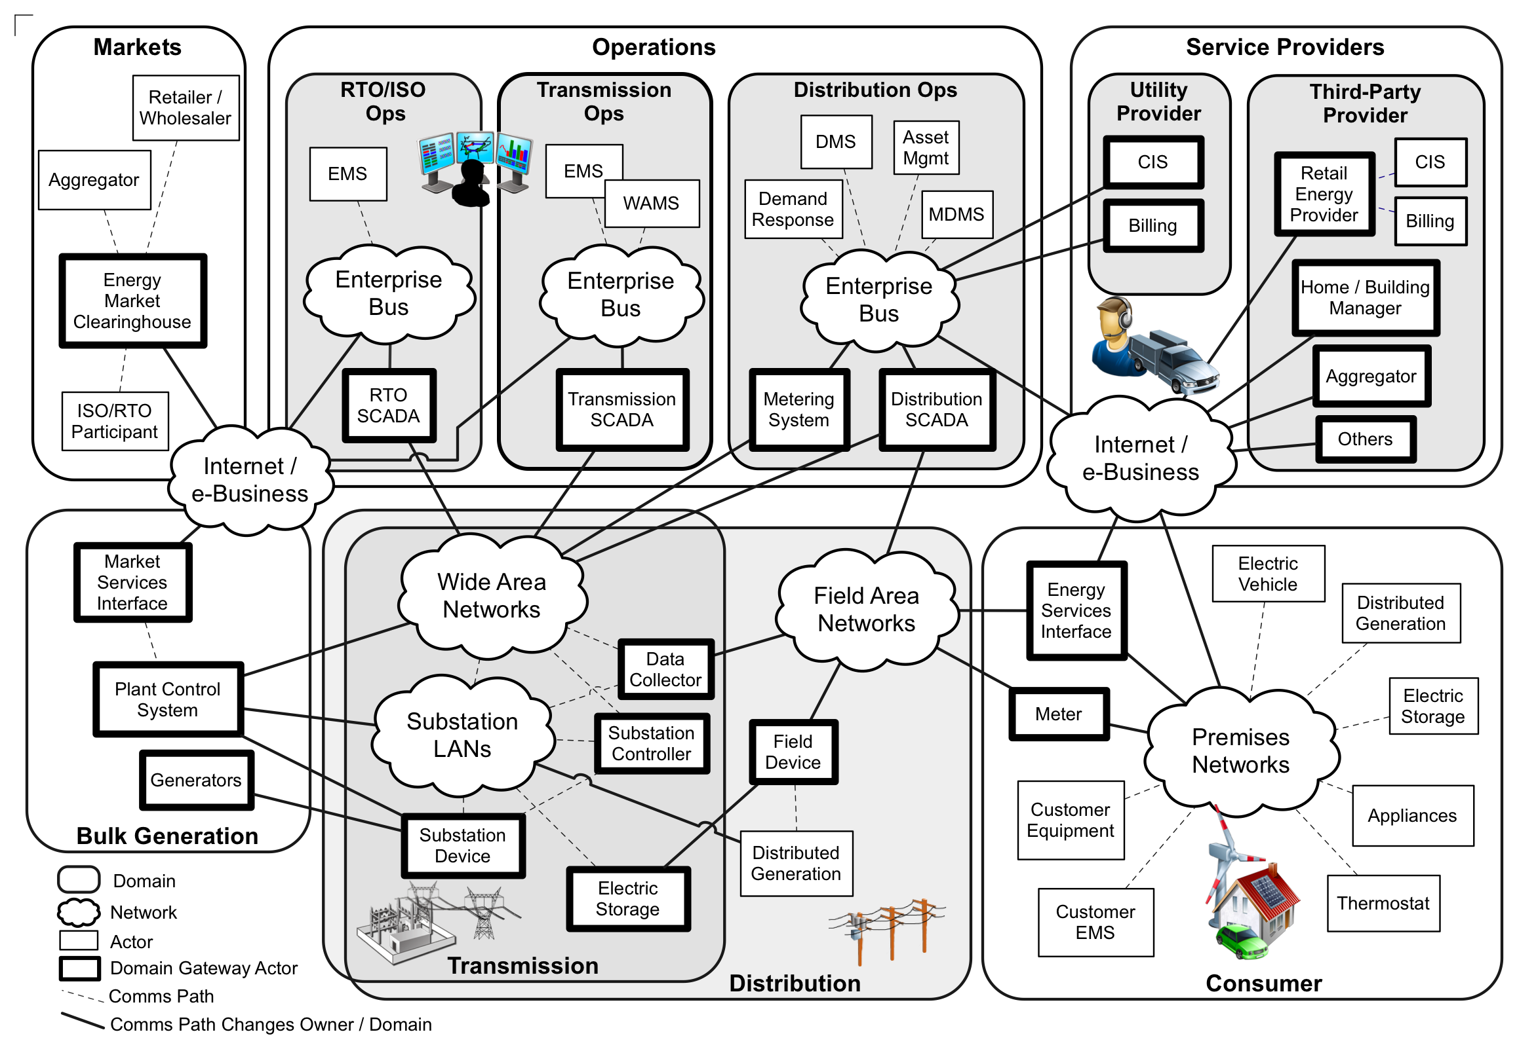
Conceptual Reference Diagram
Customer

Slide 12
Information Networks
Network of networks to improve the control and management of energy generation, distribution and consumption, and the current state of grid interconnectivity so that information can flow between the various actors in the Smart Grid.
Thorough analyses and guidelines –to be developed in the context of the priority actions plans- will determine the suitability of IP-based networks and choice of communication technologies used for various Smart Grid applications and requirements.
Access points from the public Internet to the utility networks pose potential risks that need to be analyzed and mitigated.

Slide 13
Priority Actions – expected to be completed by the end of 2009
Guidelines for the use of IP protocol suite in the Smart Grid
Guidelines for the use of wireless communications
Common specification for price and product definition
Common scheduling mechanism for energy transactions
Common Information Model (CIM) for distribution grid management
Standard DR signals
Standards for energy usage information
IEC 61850 Objects/DNP3 mapping
Transmission and distribution power systems model mapping
Energy storage interconnection guidelines
Interoperability standards to support plug-in electric vehicles
Standard meter data profiles
Cyber security risk management framework and strategy
Details can be found at http://collaborate.nist.gov/twiki-sggrid/bin/view/_SmartGridInterimRoadmap/

