Slide 1
IEEE Standards
NesCom Overview 2010
Lisa Yacone
NesCom Administrator

Slide 2
What is NesCom?
New Standards Committee
One of five governance committees of the IEEE SA-Standards Board
NesCom consists of 10-15 members, at least four of whom, including the chair, are voting members of the IEEE-SA Standards Board
Notes:
NesCom stands for the “New Standards Committee”
We are the first stop in the Standards Development Process.

Slide 3
New Standards Committee
(NesCom)
2010 Roster
Satish Aggarwal
Bill Bartley
Andy Drozd
Jean-Philippe Faure
Andy Ford
Alex Gelman
Michael Janezic
Young Kyun Kim
Thomas Lee
Hung Ling
Ted Olsen
Glenn Parsons
Tom Prevost, Chair
Jon Rosdahl
Mike Seavey
Notes:
The NesCom Roster is made up of volunteers like yourself, IEEE/SA members from various IEEE Technical Divisions. Each member is appointed to one year term by the Chair of the IEEE-SA Standards Board.
They are not compensated in any way by the IEEE. They are responsible for their own travel expenses to attend meetings.
We are grateful for these volunteers who make an important contribution of their time and energy to assist in this part of the standards development process.

Slide 4
Role of NesCom
NesCom has been delegated the responsibility of considering all Project Authorization Requests (PARS) and providing recommendations to the IEEE-SA Standards Board regarding their approval
Notes:
The NesCom committee has been given the responsibility of considering all Project Authorization requests and providing recommendations to the IEEE-SA Standards Board regarding their approval.
NesCom is also responsible for any changes to the PAR that may occur before submittal of a final document for approval.

Slide 5
NesCom Schedule
Four quarterly meetings per year
  March
  June
  September
  December
Continuous Processing – 2 to 3 times per year
  January
  April/May
  October
Meeting Schedule available: http://standards.ieee.org/board/nes/projects/meetinginfo.html
Notes:
Quarterly meetings are face to face, in conjunction with other committees of the Standards Board
We also hold Continuous Processing meetings. These are held by tele-conference. There is no Standard Board meeting in conjunction with these tele-conferences so the Recommendations are balloted by email to the Standards Board
A lot of time is spent in the review period prior to each meeting, reviewing the PARs, making comments, dialoging with the Submitters. At the meeting itself there is final opportunity for discussion of each project and then a vote to Approve, Disapprove or Defer. The vote is not final in and of itself. The end results are submitted to the Standards Board as recommendations for their final approval.

Slide 6
PAR – Project Authorization Request
An approved PAR is needed before official work is begun on a standard project. It serves as the work authorization by the IEEE-SA Standards Board
NesCom examines PARs and makes recommendations to the IEEE-SA Standards Board regarding their approval
An approved PAR is valid for 4 years
The PAR is referred to when the standard is submitted to RevCom for approval
Notes:
As mentioned earlier, a PAR is a Project Authorization Request. It’s a document submitted to request IEEE-SA approval to begin work on a project. The PAR form essentially states who is sponsoring/working on the project, the reason the project exists and what the document intends to do. You are asked to provide such items as Sponsor and Working Group information, Scope, Purpose, Stakeholder, Need and other pertinent information.

Slide 7

What is NesCom looking for?
Clarity in PAR title
Scope and Purpose of PAR
  Complete sentences and grammar
  Must match scope and purpose on draft document submitted to RevCom
Complete contact/point person information
All fields/questions must be filled out
Notes:
1.Title should be sufficiently unambiguous, understandable by a NesCom member not from the society that submitted the PAR. Acronyms must be fully spelled out in the title.
2. The scope is what you are trying to cover in the standard; the purpose is why you believe that this standard needs to exist.
For PARs approved after 01 January 2007 for new or revised standards, the scope and purpose (if applicable) must match that of the draft document submitted to RevCom
Once you fill in the WG information, this will automatically fill in the contact information
4. Any unanswered questions will raise a red flag in during the NesCom review

Slide 8
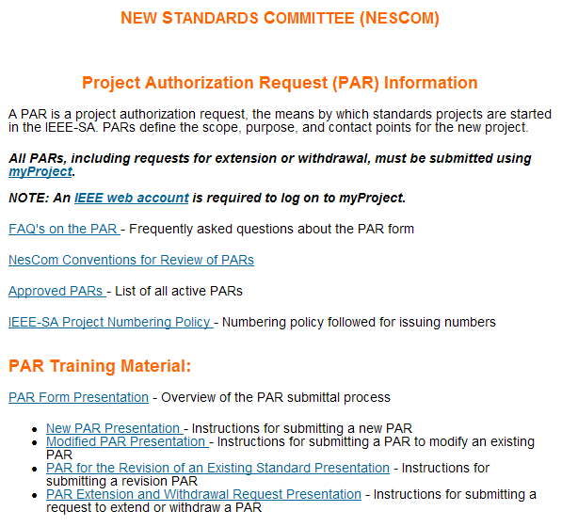
Guidance for PAR submittals

Slide 9
Submitting a PAR
The PAR must be completed via myProject (https://development.standards.ieee.org/my-site)
An IEEE web account is required. If you do not have a web account, click on the link at the bottom of the myProject home page: Need an IEEE Web Account or forget your username or password?
The PAR must be received prior to the submittal deadline for each meeting. Submittal deadline dates can be found on our website: http://standards.ieee.org/board/nes/2010calendar.pdf
Notes:
PARs are submitted using the myProject tool.
Use of myProject requires an IEEE web account. If you don’t have a web account, you can follow the link on the bottom of the log in screen to obtain one. If any of you would like assistance in doing so, you can see me anytime this week.
There are submittal deadlines for PARs to be placed on an upcoming agenda. The submittal deadline is approx. 40 days before the NesCom meeting to allow for a sufficient review period.
A calendar with the deadlines can be found on our website.

Slide 10
Five Types of PAR Requests
New Standard
Revision to an existing standard
Corrigendum to an existing standard
Amendment to an existing standard
Adoption of a non-IEEE standard

Slide 11
Three Types of PAR Actions
Modify an existing Approved PAR
Extend an Approved PAR
Withdraw an Approved PAR

Slide 12
New PAR
A new PAR is used:
To initiate a project for the first time
To work on a previously approved PAR or IEEE standard that has been withdrawn or expired.

Slide 13
PAR for the
Revision of a Standard
PAR for the Revision of an Existing Standard is used:
To make revisions to a published IEEE standard.
To revise or revive a previously withdrawn IEEE Standard

Slide 14
PAR for Amendment or Corrigendum
A Corrigendum is used to make technical corrections to an existing standard
An Amendment is used to add information to an existing standard and may correct technical information

Slide 15
PAR for the Adoption of a
Non-IEEE Standard
IEEE has agreements in place with other standards developing organizations for the adoption of non-IEEE standards
For more information, please contact Jodi Haasz, Senior Program Manager, International Standards Programs. j.haasz@ieee.org

Slide 16
PAR to Modify an approved PAR
A modified PAR is used to change the title, scope or purpose of an approved PAR to match the draft.
A modified PAR cannot be used to request an extension. An separate extension request is required. This can be submitted simultaneously with a modified PAR.
Changing the Working Group Chair does not require a modified PAR.

Slide 17
Requests to Extend or Withdraw an Approved PAR
Extension - PARs are approved for a period of 4 years. If the four years expires before submittal to RevCom, an extension request must be submitted. Extensions are requested for one to two years. Sufficient evidence of work towards completion must be presented.
Withdrawal – If the Sponsor decides not to proceed with work on a PAR, a withdrawal request must be submitted. PARs which will expire, and have not had an extension request submitted will be administratively withdrawn at the end of 4 years.
NOTE: Only Sponsor Chairs and Working Group Chairs may submit an Extension or Withdrawal Request.

Slide 18
Staff to Assist and Guide You
NesCom Administrator
  Facilitates PAR submittal process through myProject
  During NesCom review, makes requested updates to PAR form after submittal
Technical Staff Liaisons
  The staff liaison is your primary contact person for questions about procedures, policies, and process flow
Notes:
Behind the scenes the liaison and I work together to make sure the I’s are dotted and the T’s are crossed. Liaison can give guidance with PAR submittal. We compare notes often during the review process and then meet together before the NesCom meeting to go over each project to see if there is anything more we can do to help obtain approval for your project. We will work with you to resolve any outstanding issues. Please don’t hesitate to reach out for any assistance you might need.

Slide 19
Contact Information
NesCom Administrator – Lisa Yacone
  Phone: +1-732-562-6003
  Email: nescom-admin@ieee.org or l.yacone@ieee.org
Staff Liaisons:
  Michael Kipness
    Phone: 1-732-562-3810
    Email: m.kipness@ieee.org
  Kathryn Bennett
    Phone: 1-732-465-5867
    Email: k.bennett@ieee.org
IEEE Standards Website address:
  http://standards.ieee.org

